Slide 1

Profit Prediction using Regression Models
Submitted By – Pratyush Karode

Slide 2

Contents
Problem Statement
Exploratory Data Analysis
Process Flow
Results
Interpretation

Slide 3
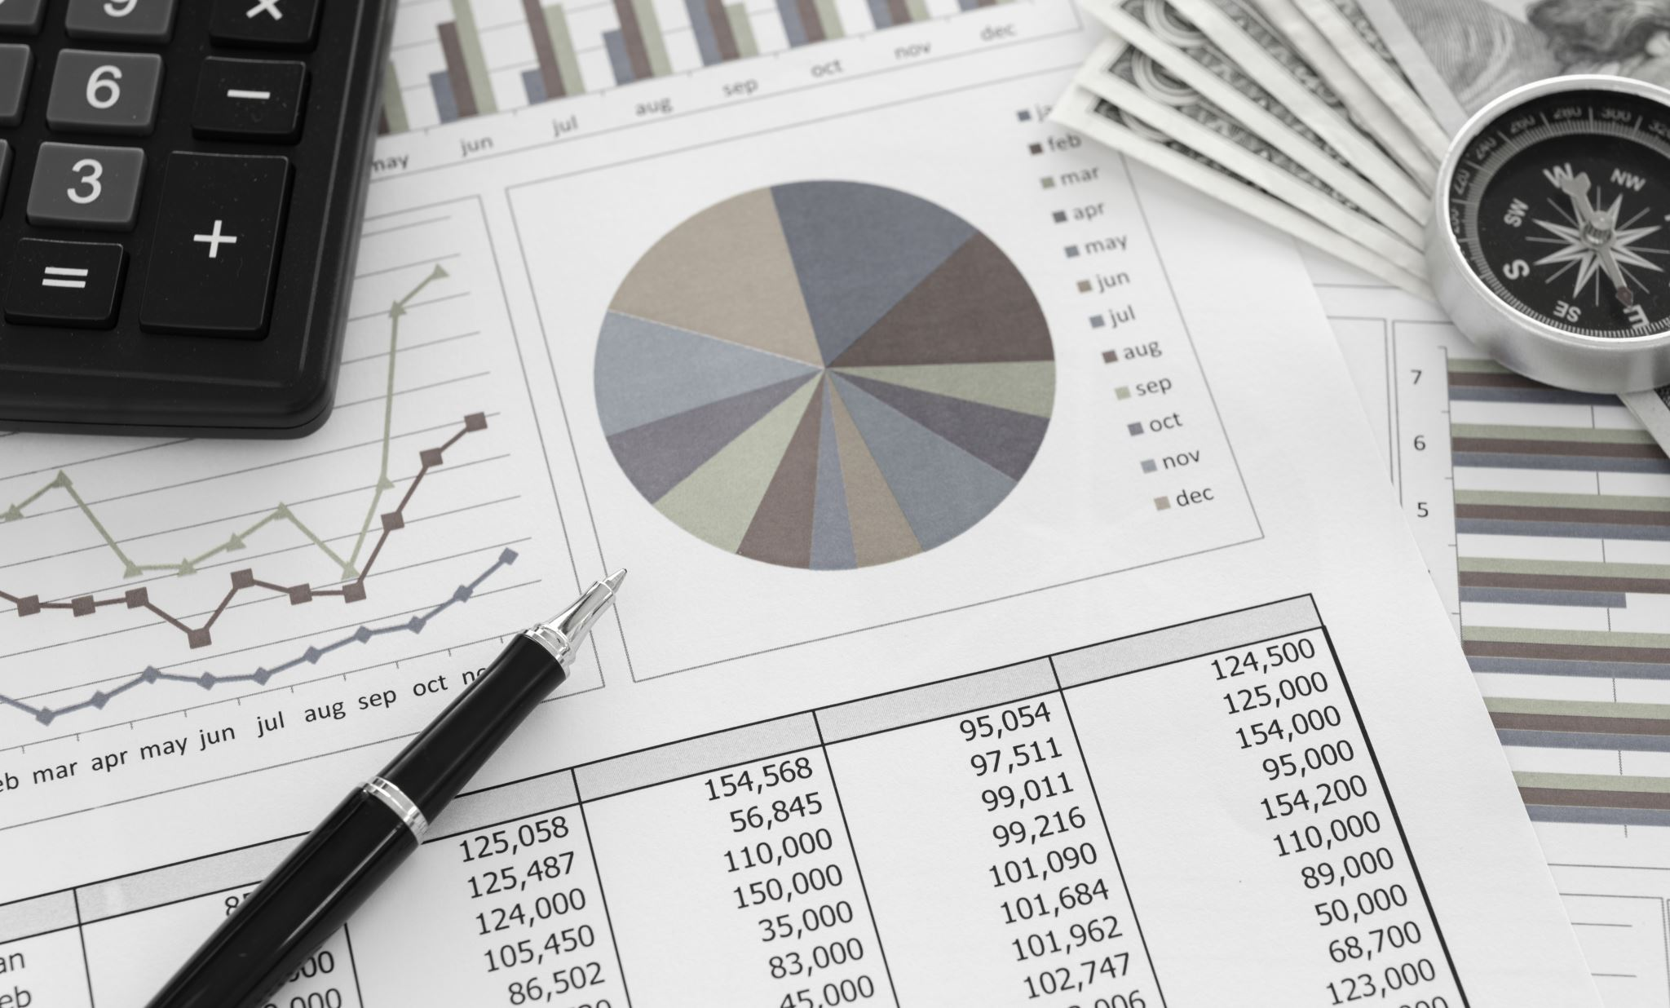
Problem Statement
Create a supervised ML model to predict profit of a new company based on it’s Marketing, Administration and R&D Spending data.

Slide 4

Process Flow
Exploratory Data Analysis
Train Test Split
Regression Models
Evaluation of Models
Selection of Models

Slide 5
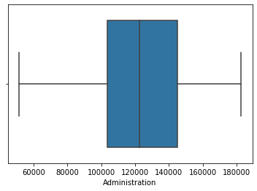
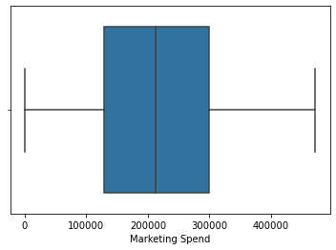
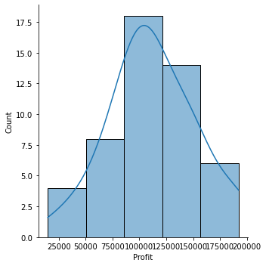
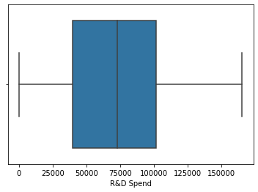
Exploratory Data Analysis
Thru Boxplot of the independent variables – Administration Spend, Marketing Spend and R&D Spend, we can see that there are no outliers in the data.
Profits are also normally distributed over the complete range of data also tells us that we are not dealing with any kind of outlier.

Slide 6
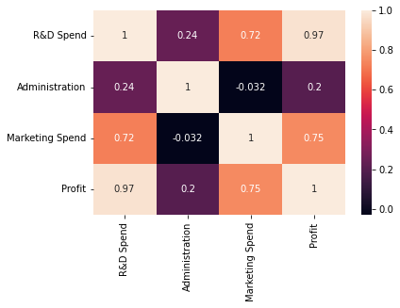
Exploratory Data Analysis
From the correlation matrix, we can see that Profits are highly correlated with R&D Spending.
Marketing Spends also has good level of correlation but administration has very low correlation to Profits.

Slide 7
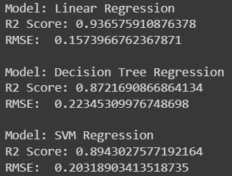
Results
In Linear regression, we just use R&D Spend as the independent variable and it gave us very high R2 Score and lowest RMSE of all.
In Decision Tree regression, we used all three independent variables, and it also gave us a high R2 Score but RMSE was highest of all.
In SVM Regression, we used all three independent variables, and got high R2 score and RMSE score lies between Linear Regression and Decision Tree models.

Slide 8
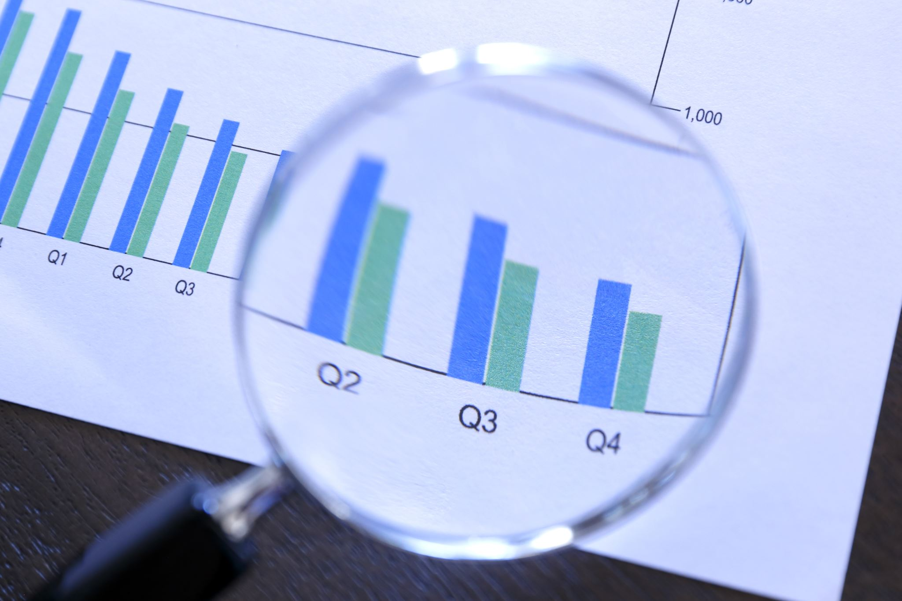
Interpretation
We see that out of the three models, Linear Regression gives us the best results.
Although, there is some error in the prediction, which can be ironed out by training the model with a large set of data.
This would decrease the overall error that is present in the current model.
Currently, we face the problem of underfitting in this data.
Linear Regression is the model we select for profit prediction.

Slide 9

THANK YOU

